Slide 1
Lab 4
Microprocessors CMPS-201
Prepared by Eng. Omar Amer

Slide 2
Today we will learn:
How to use a datasheet.
In-circuit debugging.
Assembly hacks and techniques.
More ARM assembly.

Slide 3
What is this board?

Slide 4
CC1350 Launchpad
This is an ARM-based “development” kit.
A development kit has a microprocessor along with some peripherals.
The CC1350 is a “wireless” microcontroller development kit.
It’s selling point is that it has two main peripherals:
Low-energy Bluetooth module.
Sub-1 GHz transceiver module.
Like any other kit, our kit has some GPIO pins.
All pins that are labeled DIOx on the PCB can be set as inputs or outputs depending on the application.
Notes:
Explain the advantages of using a development kit over using a bare microcontroller and using a breadboard for connections.
Explain what can be done using a sub-1 GHz module.
Home automation.
Door remote control
RFID

Slide 5
GPIO pins
The board has two LEDs, and three buttons.
Can you spot them? To what pins are they connected to?
Notes:
Give the students about 30 seconds to figure out what pins are the LEDs (and buttons) connected to.

Slide 6
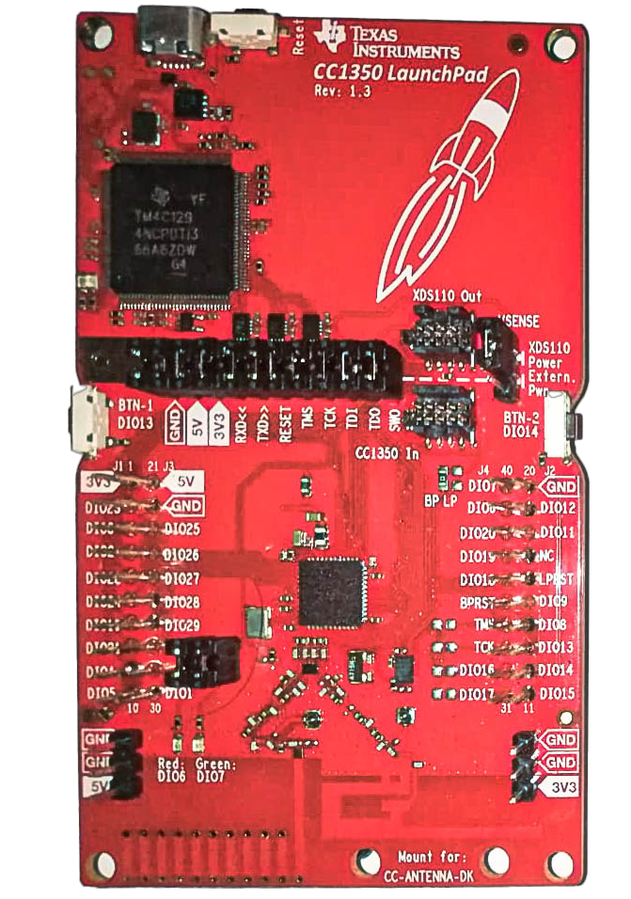
PIN
FUNC
DIO6
Red LED
DIO7
Green LED
Button 1
(left)
DIO13
DIO14
Button 2
(right)
RESET
Reset

Slide 7
Today’s Requirement
Red light/green light.
Toggle between the LEDs with BTN1
The Red LED is on at device startup.
When the user presses the button, the light switches to green.
When the user presses the button again, the light switches to red.

Slide 8
What we need to know
What pins will we toggle.
What to tell the microcontroller.

Slide 9
What to tell the Cortex-M3
We know all GPIO pins can be inputs or outputs.
We need to tell the microcontroller which pins are inputs and which are outputs.
We know we need to set DIO6 and DIO7 as outputs (these are our LEDs).
We also know that DIO13 is an input (the left button).
There has to be a way to read the inputs (to know whether the buttons are pressed or not)
We also need to find a way to toggle DIO6 and DIO7 on and off.

Slide 10
Pin direction
Most architectures that have pins that can be inputs and outputs have registers that store the direction data of each pin.
But what register controls which pin? Is it a full register for all GPIOs or a single register for each pin? So many questions…

Slide 11
Registers
Referring to r0, r1, r2, etc.. as general purpose registers implies the existence of “specific” purpose registers.
Think of these “specific” purpose registers as the control panel for the device or peripheral you are using. Any parameter that can be modified has to be in a register.
But the microprocessor has a set number of registers. Where can we add more registers to control all these different parameters?

Slide 12
Memory-Mapped registers
It’s a normal register, only located somewhere else (not next to the general purpose registers).
It lies in the address space of the microprocessor.

Slide 13
The address space
The microprocessor works by performing operations “X” on data “D” that exists at address “A”.
The range of addresses that a processor can access is called the address space.
What type of things do we expect to find at the address space of a microprocessor?

Slide 14
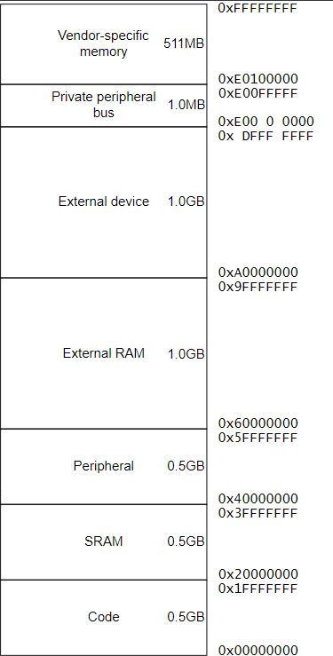

The Cortex-M3 memory map
Still, where are the registers that control the GPIOs?

Slide 15
The datasheet
Every single question that ever came, comes, will come to your mind had been already answered long ago in the datasheet.
This includes the question from the last slide.
The datasheet explains every single thing about the device in full detail.
Datasheets have one problem.
Too much information. We need to learn how to efficiently find what we need, and nothing more.

Slide 16
How to read any datasheet
If the datasheet is 50 pages or less:
Do yourself a huge favor and read it all.
Our datasheet is a “little bit” more than 50 pages.
Things to read no matter what:
The preface.
This has any naming conventions, the intended audience, and everything that can make reading the document easier.
The table of contents.
Either read it from the document itself or from your PDF reader.

Slide 17
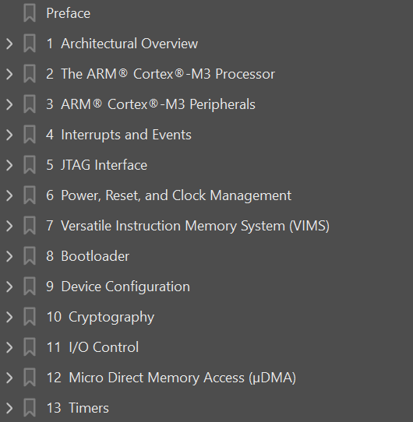
Table of contents
First we need to know: what are we looking for?
We are looking for the register that sets the direction of a GPIO pin.
Notes:
This is using Adobe reader.

Slide 18
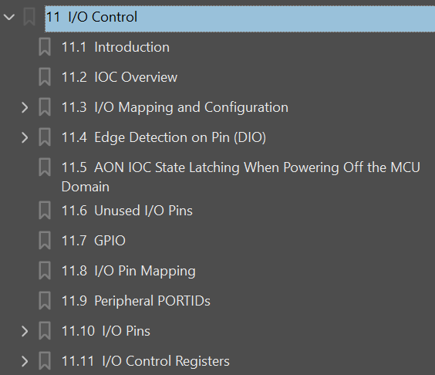
Table of contents
We know we want to control the IOs of the device. Check the I/O Control section.
Won’t hurt to skim through the introduction and the overview.
We found what we are looking for.
Lets check out the
I/O Control Registers.
Notes:
We will need to read the GPIO section first. But teach the students that it is ok to go back and forth between different sections of the document.

Slide 19
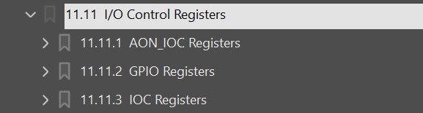
Table of contents
We see some abbreviations. If we don’t know what these mean, then now is a good time to skim through the introduction and overview.
After reading the intro and the overview, we find the following:
AON = Always On. (Does this mean that some things are not “always on” ?)
GPIO = General Purpose Input/Output
IOC = IO Control
Notes:
Remind the students that we still haven’t read a single word from the PDF

Slide 20
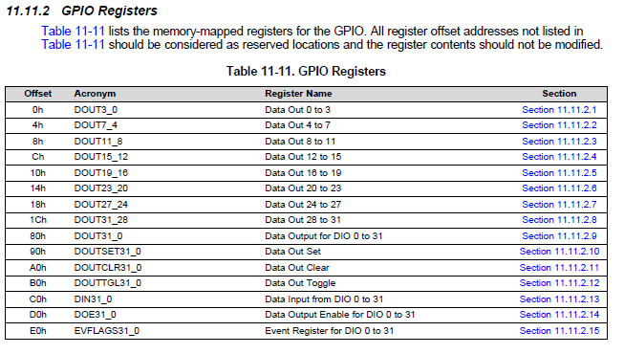
GPIO registers
Now, we can finally start reading the datasheet.
Offset?? What is the base address?
Notes:
Students have to go through the data sheet to find where the correct base address is.

Slide 21
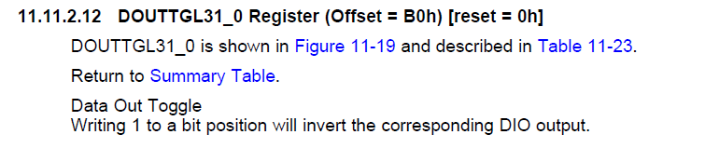
Data out toggle register
Notes:
Now would be a good time to remind the students of why this register is just what we need.
The lab requirement is the LEDs switch when a button is pressed. (If the red LED is on at startup, toggling both the red and green LEDs would meet the requirements.)

Slide 22
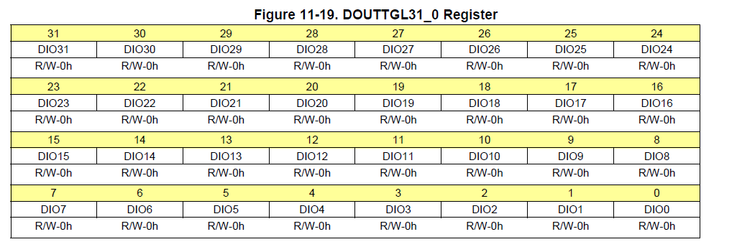
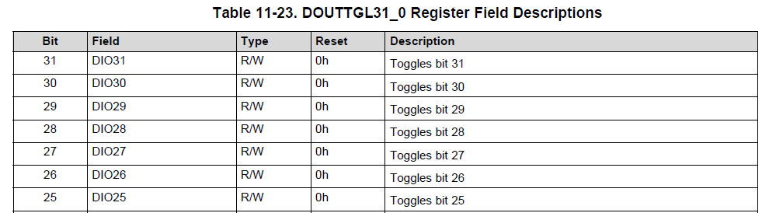
Data out toggle register
Notes:
The bottom table shows all 32 bits of course.
Truncated to fit the slide.
Explain each column in the table.

Slide 23
But how do we use it?
We know that this register toggles the output pin we tell it to.
But what else do we need to do?
Let’s check out the GPIO section in the I/O Control chapter.

Slide 24
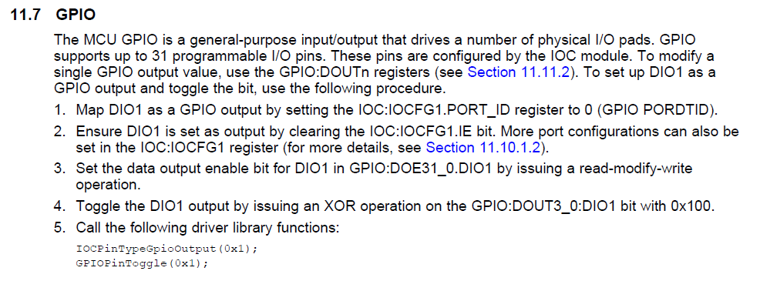
GPIO
Or you can use the register made specifically for toggling.
From the preface: The field in a register of a module is written in the data sheet as:
<Module>:<Register>.<Field>
Notes:
Note: Open PDF.
Note: Hyperlinks
Note:: CTRL+F
memory map gpio registers iocfg

Slide 25
How can we code this?
The whole program is based on writing (reading) some values at (from) certain memory locations.
Remember the syntax for loading and storing data at/to memory locations:
@ Flip Bit 16 in r2 and write the result @ in the address that r0 points to.
mov r1, #1
eor r2, r2, r1, LSL #16
ldr r0, =dout4_7_reg
str r2, [r0]
@ Read button state
ldr r1, =din31_0_reg
ldr r0, [r1]
Notes:
Homa y3mlo example b2a hena

Slide 26
To define a constant…
Magic numbers are any numbers in your code that can not be easily understood from their surrounding context.
This is horrible for readability and is considered unprofessional.
Use constants instead.
.equ constant_name, value
.equ base_addr, 0x4322A00
.equ offset, 0xc
.equ physical_addr, base_addr + offset
Notes:
Now is a good time to talk about this: The Cortex M3 doesn’t have a fancy memory management unit (MMU) to get the physical address from the base and the offset of the “virtual address” (the virtual address in ARM is the logical address in x86). To get the physical address apply this very hard equation:
Physical address = base + offset.

Slide 27
Are we missing something?
You have correctly coded the program in assembly.
You have successfully flashed the program onto the CC1350.
0 Errors 0 Warnings.
But nothing is working. The LEDs are not responding to our button presses.
What have we done wrong?

Slide 28
Initializations
Not everything is powered on at startup.
Some peripherals may be powered on, but it’s clock is inactive at startup.
All of these are common power saving techniques:
Power on only what you need, power off what you don’t.
We need to power up these peripherals. This is the first thing you should do.

Slide 29
Will it work now?
The code will work, but it will work in an inconsistent manner.
Works once, doesn’t work the next two presses, etc.…
In this case, our inputs are nothing but suggestions to the hardware.
Why is that?

Slide 30
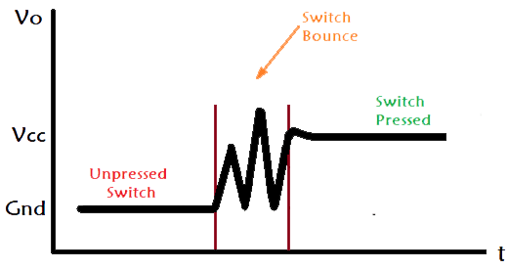
How switches work
Notes:
We need to fix this.

Slide 31
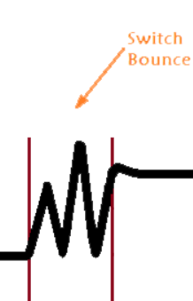
Switch debouncing
The switch bounces from GND to VDD.
This is equivalent to a random amount of presses per single “human” press.
Not reliable and unpredictable. This is a problem we need to solve.
A number of methods exist to debounce a switch.
Hardware solutions.
Software solutions.
Each solution has its own set of pros and cons.
We will be using a delay loop to wait out the part of this signal.

Slide 32
Using the Program

Slide 33
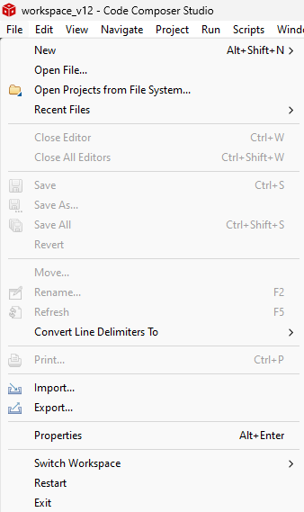
Using the Code Composer Studio
Step 1: File
Import the project you downloaded earlier:
Step 2: Import
Notes:
FILE IMPORT
PROJECT IMPORT
NOT THE IMPORT ELE 3la EL SHEMAL

Slide 34
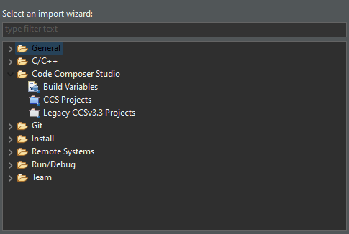
Importing a project
Step 1: Code Composer Studio
Step 2: CCS Projects

Slide 35
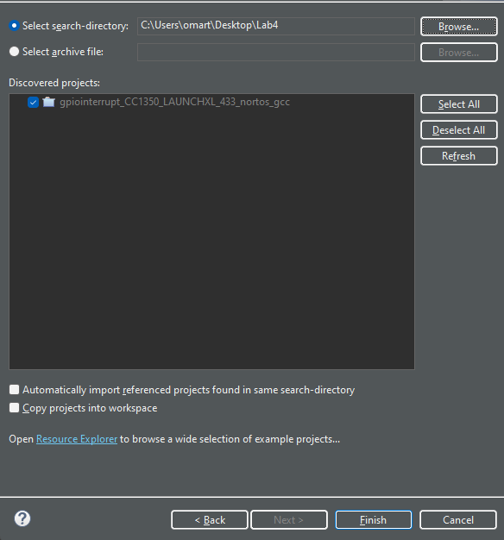
Importing a project
Step 1: Browse for the downloaded project
Step 2: Finish.

Slide 36
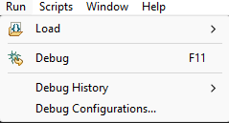
Running and debugging
With the board connected to your computer:
Step 1: Run
Step 2: Debug

Slide 37
In circuit debugging
We run our code on the board, and the computer can tell the board to stop
execution and/or single step so that we can debug the hardware.
C++ Debugging
C++ Step Over/Into
ASM Debugging
ASM Step Over/Into

Slide 38
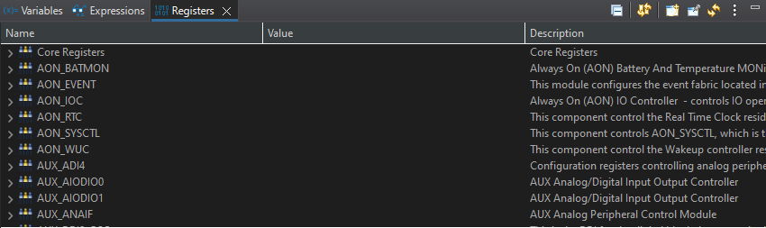
Variables, expressions, and registers
Here we can see the registers of the hardware and their values.

Slide 39
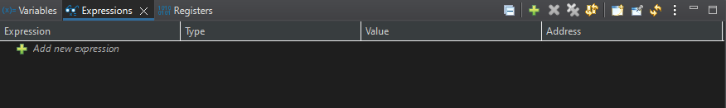
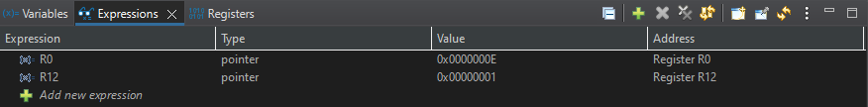
Variables, expressions, and registers
Here we can watch certain values we care about instead of all the registers

Slide 40
Any questions?
“There are no foolish questions and no man becomes a fool until he has stopped asking questions.” – Charles Proteus Steinmetz

Slide 41
Requirements
Use the datasheet to find the memory map of the Cortex M3.
Memorize the page number. You will need this later.
[HINT] Try looking in the Cortex M3 peripheral chapter.
Complete the given code such that by pressing the left button the light switches from one LED to another.
Load the program onto the board.

Slide 42
Hint!

Slide 43
START
NO
Set Green LED → Output
Pressed?
Read Button
Turn Red LED ON
Set Red LED → Output
Set Button 1 → Input
YES
YES
Toggle Green LED
Read Button
Still pressed?
NO
Wait for DEBOUNCING
Toggle Red LED

Slide 44
Another Hint!

Slide 45
t_light:
@ 1. Set the LED pins as outputs
ldr r0, =doe31_0_reg
mov r1, #1
mov r2, #0
orr r2, r2, r1, LSL #green_led
orr r2, r2, r1, LSL #red_led
str r2, [r0]
@ 2. Set the buttons as inputs
ldr r0, =iocfg_btn
mov r1, #1
mov r2, #0
orr r2, r2, r1, LSL 29
str r2, [r0]
@ 3. Turn On RED by default
mov r2, #0
eor r2, r2, r1, LSL #16
ldr r0, =dout4_7_reg
str r2, [r0]
To do literally anything, we need a read-modify-write operation.
Keep this in mind.

Slide 46
Thank you.

